Slide 1

COVID-19 Cases Database
By: Caleb German, Ethan McFarland, Andrew Bellas, Suban Burale

Slide 2
Roles
Suban: database designer, system analysts
Caleb: database designer, system analysts
Ethan: Application programmer, DBMS system designer and implementor
Andrew: Application programmer, DBMS system designer and implementor

Slide 3
Problem/Solution
Lack of proper ways to obtain data for COVID-19 cases
Track the impact of COVID in different communities and demographics
Purpose of database: Create a database that contains data on COVID-19 cases by zip code, hospital, and population demographics
Database is only a proof of concept

Slide 4
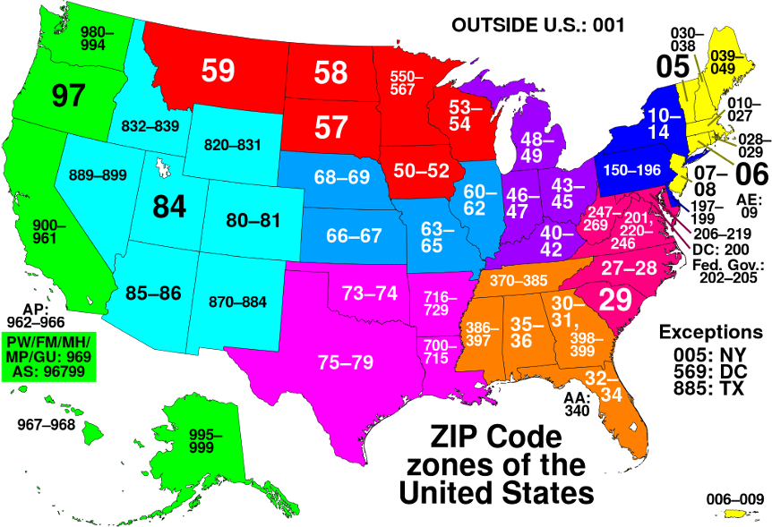
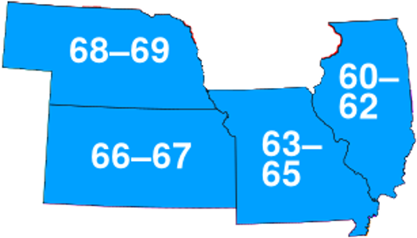
Domain
Restricted our focus to a subset of Midwest states.
Specifically, states that have zip codes starting with 6 (e.g. Missouri, Illinois, Kansas, Nebraska).

Slide 5
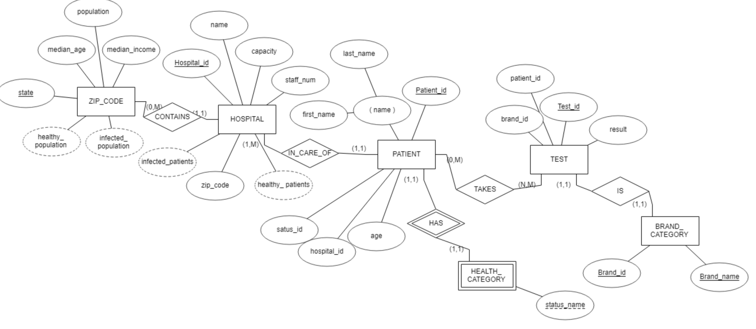
ER Diagram
Notes:
As COVID-19 has spread throughout our communities, there is a rising need to track the spread of this pandemic, and how it effects communities, hospitals, and families
To solve this pressing need, we will need to be able to record data for how hospitals with varying occupancies, capacities, and staff numbers, are handling patients of different health severities

Slide 6
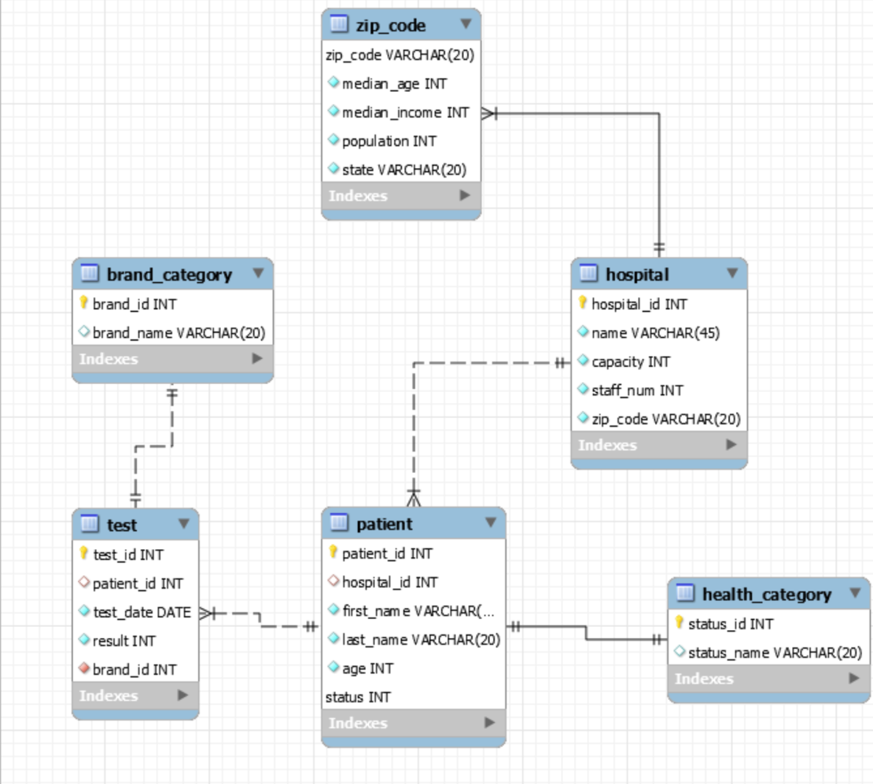
Design
Retrieves number of infected patients by zip code and state
Retrieves information about patients by hospital
Test/equipment hospital is using
Demographic information such as median income and age of populations

Slide 7
Accomplishments
Implemented course material into a demo application
Positive collaborative environment
Demo application related to a current need

